Slide 1
Connections for Women
Kim Goodman
WMCLB Information Coordinator

Slide 2
Social Media….What is it?
Think of regular media as a one-way street where you can read a newspaper or listen to a report on television, but you have very limited ability to give your thoughts on the matter.
Social media, on the other hand, is a two-way street that gives you the ability to create, share and/or exchange information on a highly interactive platform.

Slide 3
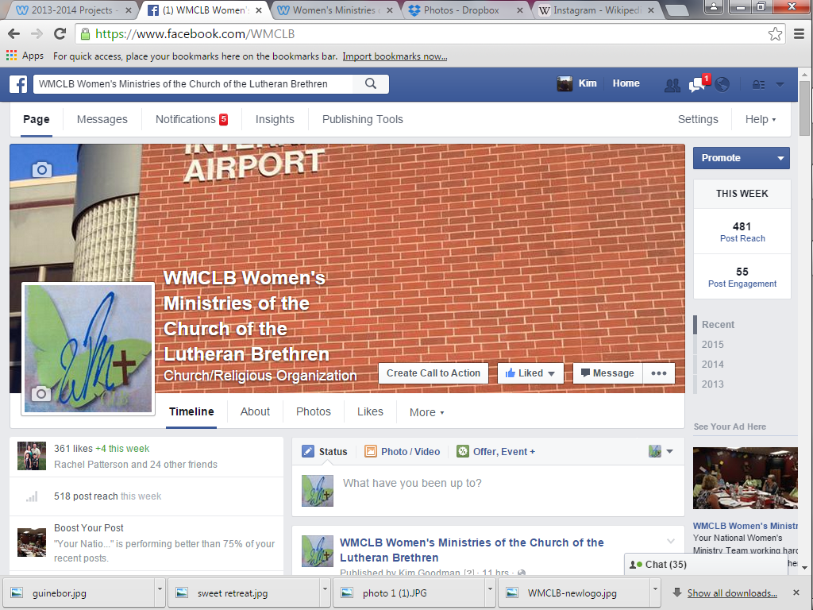
Types of Social Media/Sharing
is the most popular and recognized social networking site.
Add friends, share pictures, “like”, comment, join a group. You can do it all here.

Slide 4
Types of Social Media/Sharing
Twitter is an online social networking service that allows users to send and read short 140 character messages called tweets.
Instagram is an online mobile photo-sharing, video sharing and social networking service that allows users to take pictures and videos and share them on a variety of social networking platforms such as Facebook, Twitter, and Tumblr

Slide 5
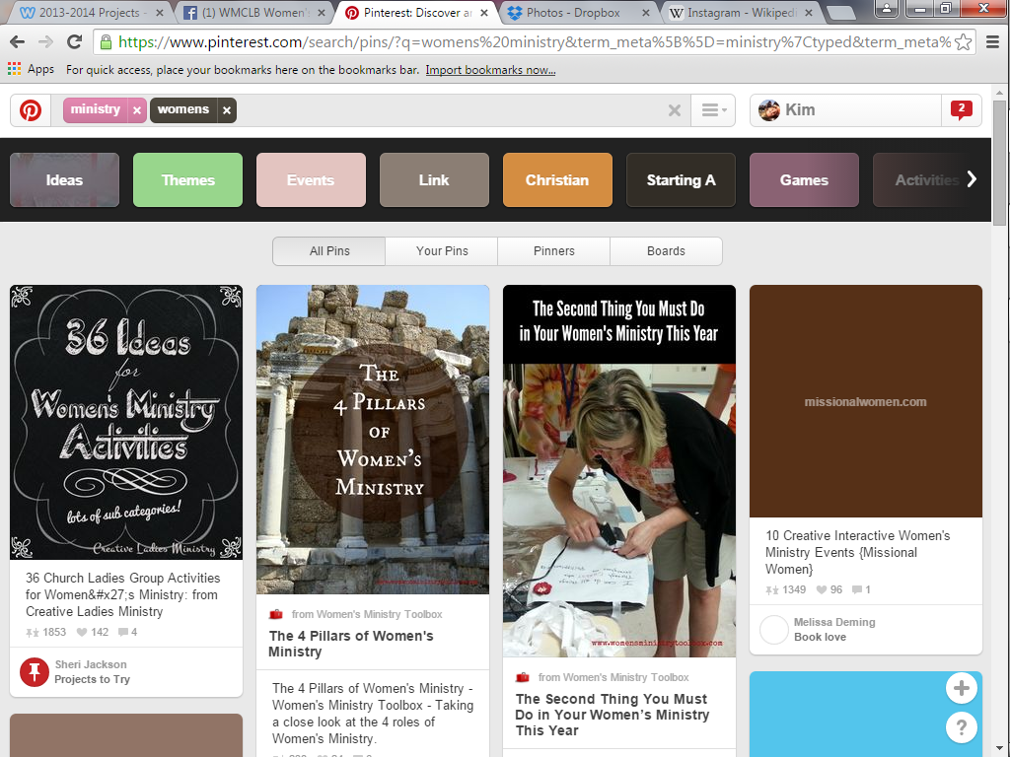
Types of Social Media/Sharing
An enormous photo sharing website.
“Pin” your favorite recipe or search for your next Sunday School craft.

Slide 6
Types of Social Media/Sharing
Users post multimedia and other content to a short form blog.
Wait….what is a blog?
A blog is a discussion on a website. Think of it like a journal on the internet.
Notes:
Example of a blog site
www.hesowsandshesews.com

Slide 7
Information OVERLOAD!!!
Likes, tweets, pins…. How much is enough?
Do I have to comment on everything?
Rachel friended me, but I don’t like what she posts. What do I do now?
I quit! This is too much!
Notes:
Don’t be discouraged!
Consider the positives…..
Bridges the distance gap.
Can people together.

Slide 8
Does my church need to tweet?
Social media can be a valuable tool in your ministry tool kit.
Are you starting a bible study?
Planning a women’s event?
Need to encourage your women?
Notes:
You can start an online discussion to find out what others would like to study. What day/time works best for everybody? Do you need to arrange childcare?
Are you having a church Picnic? Create a Facebook event. Now your friends can invite their friends and their friends’ friends. How’s that for an outreach tool?
Encourage? Tweet a link to an encouraging article. Share about your favorite blog in a Facebook post. Pin an encouraging note on your Pinterest board.

Slide 9
Before you post, consider this…
Is this my information to share?
Will I be okay with absolutely anyone seeing this?
Am I using this as an emotional dumping ground?

Slide 10
Before you post, consider this…
Will anyone really care about this content besides me?
Will I offend anyone with this content?
Is this appropriate for a social portal, or would it best be communicated another way?

Slide 11
Envy, Jealousy, the downside…
Remember when…..
Catching up meant having lunch with our close friends to see pictures of their fabulous vacation or their new grandbaby or hear about their exciting promotion?
Honest-to-goodness real-life
face to face communication

Slide 12
Envy, Jealousy, the downside…
Now…..
Online we see the highlights of the lives of every person we’ve ever “friended”– whether they’re actual friends, or people we’ve only met a time or two.
Notes:
For instance, some might present "retouched" versions of their lives on social media, only sharing the best and the prettiest. The term "humble brag" has even been coined to refer to posts like "I'm so blessed! My beautiful wife took me out to the best restaurant for our anniversary!"
We showcase filtered photos of clean kids, blurring out (or even cropping out) the sink full of dirty dishes in the background. These posts show an unrealistic view of real life, and can be discouraging to others. Discipleship is about what God is doing right here, right now, right in the midst of the mess and chaos of our real lives. And that's the picture we could be presenting on social media.
It's not just what we post, either. For many, social media has become the new time suck, pushing even TV down the list. The Bible is clear that we need rest, and we can help our group members discover healthy ways to engage social media—especially knowing when to turn it off.

Slide 13
The more you know…
Like technology, social media changes constantly. Ask your friends if you don’t know about something. Research it on the internet. Ask your Youth Pastor. You could even ask your children (they know EVERYTHING!)
Pay attention to what your children are doing on the internet and their phones
Notes:
Snapchat is a picture/video messaging site. It can be a hilarious way to send selfies to your friends but, it can also be ripe environment for inappropriate content.

Slide 14
When you consider your social presence…
Be real
Be genuine
Be sincere
Be a light for His glory
Imagine the possibilities.

Slide 15
WMCLB Information
Women’s Ministry Church of the Lutheran Brethren website, www.wmclb.com
Have you “Liked” the WMCLB Facebook page? Find links to event information, monthly devotions, encouragement and inspirations.
Does your region have a Facebook page/group?
If so, “Like” it!
Center for parent/youth understanding
www.cpyu.org

Slide 16
Questions?

